Slide 1
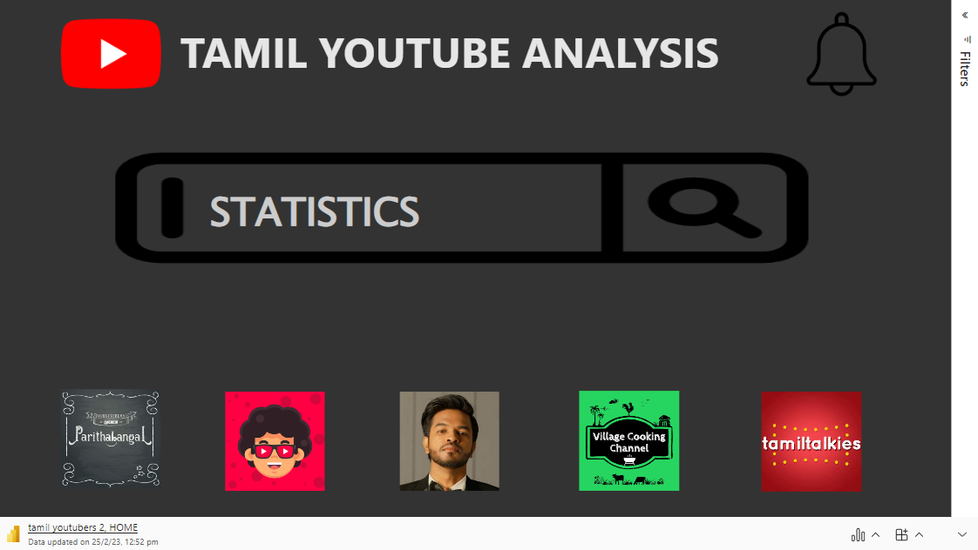

Slide 2
NAVIGATION
Click on the PICTURES at the bottom to know each of their info.
Click on the SEARCH ICON to view the statistics of the youtubers
Click on the BELL ICON the get to the end .

